Slide 1
Chapter 4
Managing Conflict and the Art of Negotiation

Slide 2
Conflict and Negotiation
Conflict: the process which begins when one party perceives that the other has frustrated some concern of his
Our concern is goal conflicts that occur when a group pursues goals different from other groups
Negotiation: the skills required to resolve most conflicts
4-<number>

Slide 3
Identifying and Analyzing Stakeholders
Identify stakeholders
  Usually through expert judgment of PM
  Create stakeholder register
  Create stakeholder issue log
Analyze stakeholders
  Update stakeholder register
  Power-Interest Grid
  Commitment Assessment Matrix
4-<number>

Slide 4
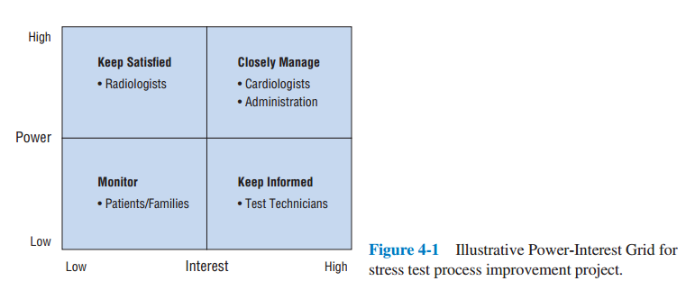
Power-Interest Grid
4-<number>

Slide 5
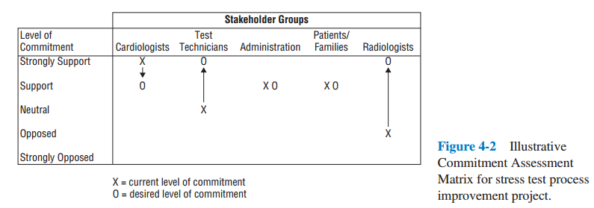
Commitment Assessment Matrix
4-<number>

Slide 6
Managing Stakeholder Engagement
Obtain and conform stakeholder commitment
Communicate with stakeholders
Proactively address stakeholder concerns
Resolve issues in a timely fashion
4-<number>

Slide 7
Project Life Cycle
Conceptualization
Planning
Execution
Termination
4-<number>

Slide 8
Categories of Conflict
Different goals and expectations
Uncertainty about authority
Interpersonal conflict
4-<number>

Slide 9
Project Formation
Conflict centers around the confusion of starting a new project
  Many of the policies and procedures have not yet been formed
  The objectives of the project are not yet finalized
Conflict cannot be avoided at this phase
In fact, much of this conflict is good conflict
4-<number>

Slide 10
Handling Project Formation Conflict
Four fundamental issues must be handled to get order
  Technical objectives must be set
  Senior management and line managers must commit to the project
  The priority for the project must be set
  Organizational structure of the project must be established
4-<number>

Slide 11
Project Buildup
Conflicts tend to be technical in nature
Conflicts between the PM and the functional areas tend to predominate
4-<number>

Slide 12
Main Program
Schedules are a major source of conflict
Some tasks will be late and the schedule should be adjusted or the time made up
The more complex the project, the more difficult it is to trace the sources of conflict
There are also technical conflicts
4-<number>

Slide 13
Project Phase-Out
Deadlines are a major source of conflict
Technical problems are rare
Personality conflicts will be a big deal due to time pressures
4-<number>

Slide 14
Dealing With Conflict
People deal with conflict along two dimensions
  Assertive → Unassertive
  Cooperative → Uncooperative
4-<number>

Slide 15
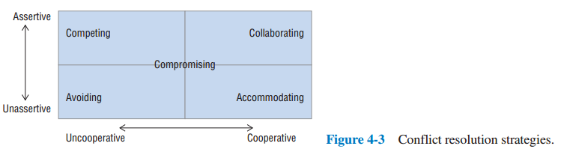
Conflict Resolution Strategies
4-<number>

Slide 16
Strategies to Deal with Conflict
Competing
Avoiding
Collaborating
Accommodating
Compromising
4-<number>

Slide 17
The Nature of Negotiation
The process through which two or more parties seek an acceptable rate of exchange for items they own or control
Parties to a negotiation often see themselves as opponents
  “If they win, I lose”
Project manager must avoid this on projects as all stakeholders are interrelated
4-<number>

Slide 18
Partnering, Chartering, and Change
Three common situations that call for negotiating skills
  Use of subcontractors
  Use of input from two or more functional units
  Management of change
4-<number>

Slide 19
Partnering
Project firm and subcontractors are at odds on a project
Project firm wants high quality and low cost
Subcontractors want high profits and maximum flexibility
Partnering has been developed to replace this atmosphere with one of cooperation and mutual helpfulness
4-<number>

Slide 20
Project Partnering
A method of transforming contractual relationships into a cohesive, cooperative project team with a single set of goals and established procedures for resolving disputes in a timely and effective manner
4-<number>

Slide 21
Steps for Project Partnering
Project firm must commit to partnering
All parties must implement the process
Joint review when finished
4-<number>

Slide 22
1. Project Firm Commit to Partnering
Select committed subcontractors
Joint team-building exercises
Develop a project charter
4-<number>

Slide 23
2. All parties must implement the process
…using a four-part agreement
  Joint evaluation of the project’s progress
  A method for resolving disagreements
  Continuous improvement
  Support from the senior management
4-<number>

Slide 24
3. Joint Review
Setting this up requires a lot of negotiation
Negotiations must be nonadversarial in nature
It has worked well in some settings
4-<number>

Slide 25
Problems With Partnering
Requires strong support from senior mgmt.
Requires continuous support of project objectives and partnering agreements
Requires open and honest communication
4-<number>

Slide 26
Chartering
Project Charter - A written agreement that outlines the specifics of the project
Contains expected deliverables and resource commitments
Agreeing to a charter implies that none of the parties will change the agreement unilaterally
4-<number>

Slide 27
Scope Change
The initial assessment was wrong
Project team learns more about the project
Change is mandated
Client ask for changes
4-<number>

Slide 28
Some Requirements and Principles of Negotiation
Few conflicts have to do with whether or not a task will be undertaken
Instead, they have to do with the design of the deliverable
  How
  Whom
  When
  What cost
The work of the project should get done
  If not, everyone loses
4-<number>

Slide 29
Requirements for Conflict Reduction Methods
They must allow the conflict to be settled without irreparable harm to the project’s objectives
They allow and foster honesty between the negotiators
Win-win situation for all parties involved
4-<number>

Slide 30
Principled Negotiation
Separate the people from the problem
Focus on interests, not positions
Before trying to reach agreement, invent options for mutual gain
Insist on using objective criteria
4-<number>

Slide 31
Copyright
Copyright © 2018 John Wiley & Sons, Inc.
All rights reserved. Reproduction or translation of this work beyond that permitted in Section 117 of the 1976 United States Act without the express written permission of the copyright owner is unlawful. Request for further information should be addressed to the Permissions Department, John Wiley & Sons, Inc. The purchaser may make back-up copies for his/her own use only and not for distribution or resale. The Publisher assumes no responsibility for errors, omissions, or damages, caused by the use of these programs or from the use of the information contained herein.
Copyright ©2018 John Wiley & Son, Inc.

